Slide 1
Dijkstra's algorithm ; Shortest Path First (SPF)
Michael Ghoorchian

Slide 2
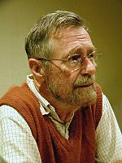
Edsger W. Dijkstra (1930-2002)
Dutch Computer Scientist
Received Turing Award for contribution to developing programming languages.
Contributed to :
Shortest path-algorithm, also known as Dijkstra's algorithm;
Reverse Polish Notation and related Shunting yard algorithm; t
THE multiprogramming system;
Banker's algorithm;
Self-stabilization – an alternative way to ensure the reliability of the system.
www.math.bas.bg/.../EWDwww.jpg

Slide 3
Dijkestra’s Algorithm or Shortest path First
Dijkstra's algorithm is used in SPF, Shortest Path First, which is used in the routing protocol OSPF, Open Shortest Path First
Routing :
A protocol that specifies how routers communicate
with each other, disseminating information that
enables them to select routes between any two nodes
on a computer network.

Slide 4
Shortest Path Algorithm :
This algorithm has been used in GPS navigating systems.
For a given source vertex (node) in the graph, the algorithm can be used to find shortest path from a single starting vertex to a single destination vertex.
For example, if the vertices of the graph represent cities and edge path costs represent driving distances between pairs of cities connected by a direct road, Dijkstra's algorithm can be used to find the shortest route between one city (a) and destination city (b).
www.criticalblue.com

Slide 5
Shortest Path First (SPF) Algorithm :
This algorithm is widely used in routing protocol systems
It is also called the single-source shortest path problem , in which the shortest paths from a single source (vertex) to all other vertices has to be found.
In the next example; for a given source vertex (node) in the graph, the algorithm finds the path with the shortest path between that vertex and every other vertex. A Java applet has been used to show the process step by step.

Slide 6
Dijkstra’s Algorithm
Assumes no negative-weight edges.
Maintains a set S of vertices whose SP from s has been determined.
Repeatedly selects u in V–S with minimum SP estimate (greedy choice).
Store V–S in priority queue Q.
Initialize(G, s);
S := ∅;
Q := V[G];
while Q ≠ ∅ do
u := Extract-Min(Q);
S := S ∪ {u};
for each v ∈ Adj[u] do
Relax(u, v, w)
od
od

Slide 7
Example
u
v
∞
1
∞
10
9
2
3
s
0
4
6
5
7
∞
∞
2
x
y

Slide 8
Example
u
v
10
1
∞
10
9
2
3
s
0
4
6
5
7
5
∞
2
x
y

Slide 9
Example
u
v
8
1
14
10
9
2
3
s
0
4
6
5
7
5
7
2
x
y

Slide 10
Example
u
v
8
1
13
10
9
2
3
s
0
4
6
5
7
5
7
2
x
y

Slide 11
Example
u
v
8
1
9
10
9
2
3
s
0
4
6
5
7
5
7
2
x
y

Slide 12
Example
u
v
8
1
9
10
9
2
3
s
0
4
6
5
7
5
7
2
x
y

Slide 13
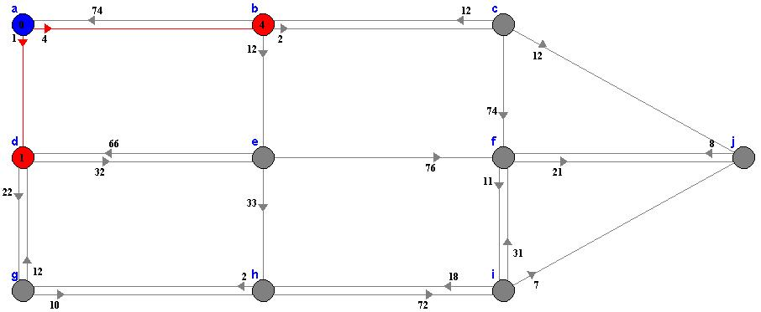
Example of shortest path first (SPF) in routing :
Red arrows point to nodes reachable from the start node a .
The distance to: b=4, d=1. Node d has the minimum distance.
Any other path to d visits another red node, and will be longer than 1.
On the next step , node d will be colored orange to indicate 1 is the length of the shortest path to d.
Java Applet Copyright Carla Laffra of Pace University ; http://www.dgp.toronto.edu/people/JamesStewart/270/9798s/Laffra

Slide 14
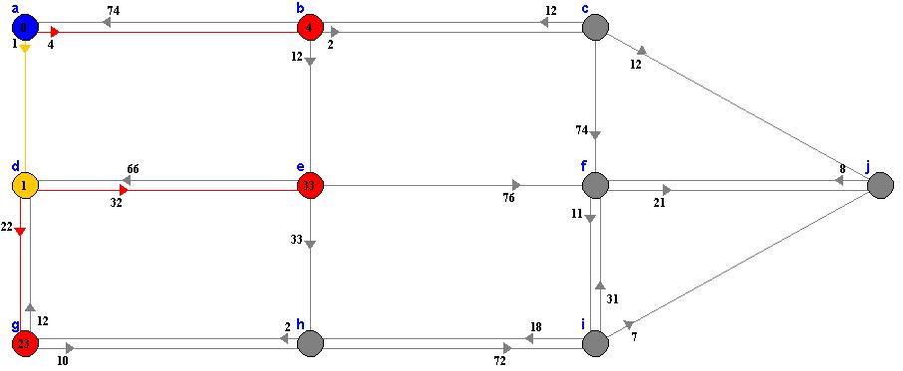
STEP 2
Red arrows point to nodes reachable from nodes that already have a final distance.
The distance to: b=4, e=33, g=23. Node b has the minimum distance.
Any other path to b visits another red node, and will be longer than 4.
On the next step, node b will be colored orange to indicate 4 is the length of the shortest path to b.

Slide 15
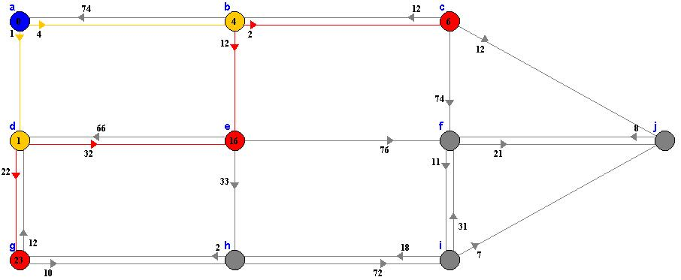
STEP 3
Red arrows point to nodes reachable from nodes that already have a final distance.
The distance to: c=6, e=16, g=23. Notice that the distance to e, has changed!
Node c has the minimum distance.
There are no other arrows coming in to c.
On the next step, node c will be colored orange to indicate 6 is the length of the shortest path to c.

Slide 16
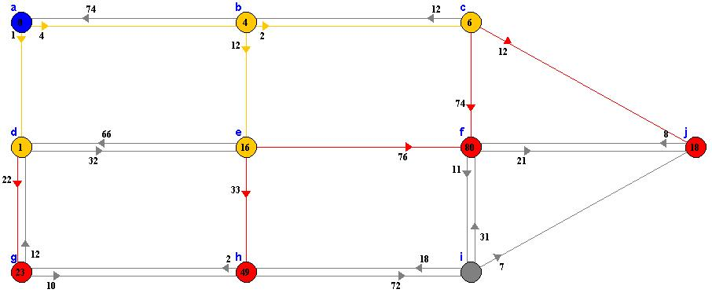
STEP 4
Red arrows point to nodes reachable from nodes that already have a final distance.
The distance to: e=16, f=80, g=23, j=18. Node e has the minimum distance.
There are no other arrows coming in to e.
On the next step , e will be colored orange to indicate 16 is the length of the shortest path to e.

Slide 17
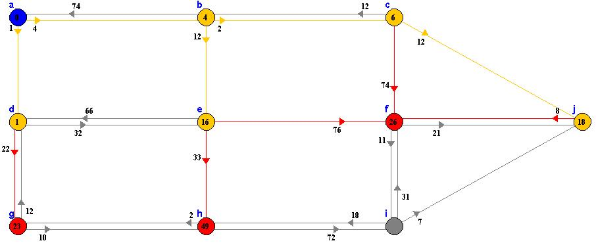
STEP 5
Red arrows point to nodes reachable from nodes that already have a final distance.
The distance to: f=80, g=23, h=49, j=18. Node j has the minimum distance.
Any other path to j visits another red node, and will be longer than 18.
Node j will be colored orange to indicate 18 is the length of the shortest path to j.

Slide 18
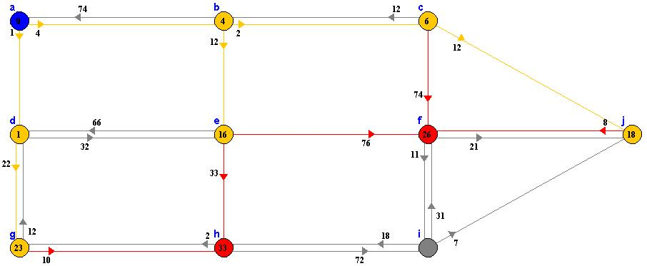
STEP 6
Red arrows point to nodes reachable from nodes that already have a final distance.
The distance to: f=26, g=23, h=49. Notice that the distance to f, has changed!
Node g has the minimum distance.
Any other path to g visits another red node, and will be longer than 23.
Node g will be colored orange to indicate 23 is the length of the shortest path to g.

Slide 19
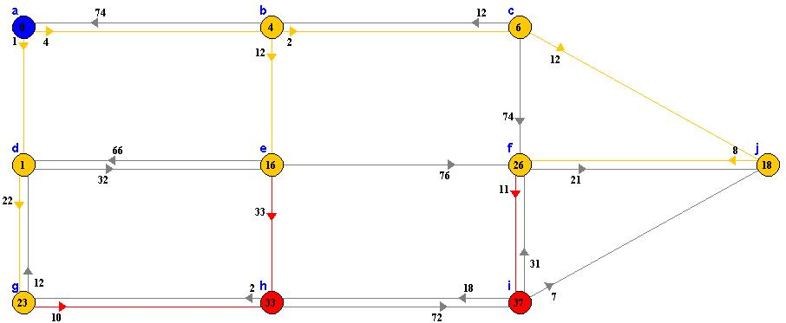
STEP 7
Step 7: Red arrows point to nodes reachable from nodes that already have a final distance.
The distance to: f=26, h=33. Notice that the distance to h, has changed!
Node f has the minimum distance.
Any other path to f visits another red node, and will be longer than 26.
Node f will be colored orange to indicate 26 is the length of the shortest path to f.

Slide 20
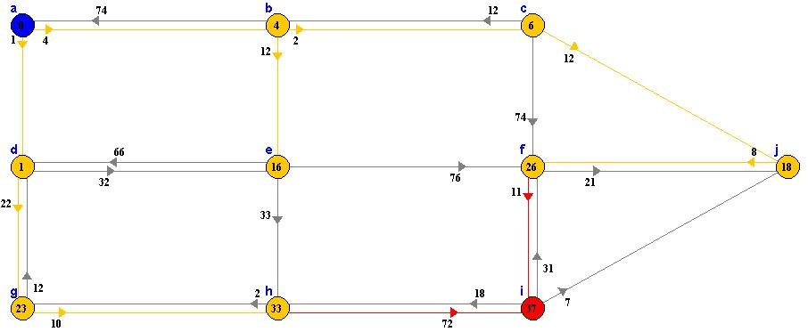
STEP 8
Step 8: Red arrows point to nodes reachable from nodes that already have a final distance.
The distance to: h=33, i=37. Node h has the minimum distance.
Any other path to h visits another red node, and will be longer than 33.
Node h will be colored orange to indicate 33 is the length of the shortest path to h.

Slide 21
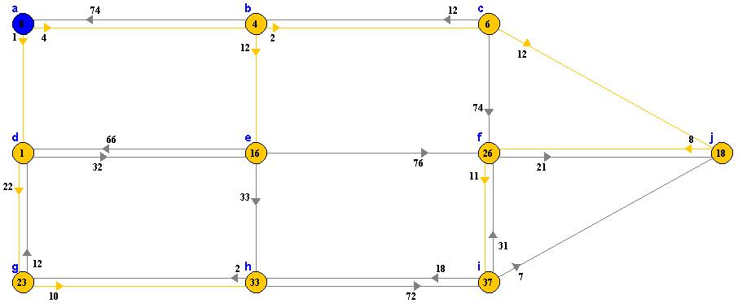
Last step
Step 9: Red arrows point to nodes reachable from nodes that already have a final distance.
The distance to: i=37. There are no other arrows coming in to i.
Node i will be colored orange to indicate 37 is the length of the shortest path to i.
Algorithm has finished, follow orange arrows from start node to any node to get
the shortest path to the node. The length of the path is written in the node.

Slide 22
Does Dijkstra’s Algorithm works everywhere ?
While it finds the shortest path with lower running time , It does not work with negative weight of edges in some networks.
In this case, Bellman-Ford algorithm can be used which is very similar to Dijkstra's algorithm, but instead of selecting the minimum-weight node not yet processed to relax, it simply relaxes all the edges, and does this |N| − 1 times, where |N| is the number of vertices .

Slide 23
Reference :
Introduction to Algorithms by Cormen, Leiserson and Rivest (MIT Press/McGraw-Hill 1994, ISBN 0-262-03141-8 (MIT Press) and ISBN 0-07-013143-0 (McGraw-Hill).
http://en.wikipedia.org/wiki/BellmanFord_algorithm
http://en.wikipedia.org/wiki/Dijkstra_algorithm
www.Criticalblue.com
http://www.cs.mcgill.ca/~cs251/OldCourses/1997/topic29/
Introduction to Algorithms by Cormen, Leiserson and Rivest (MIT Press/McGraw-Hill 1994, ISBN 0-262-03141-8 (MIT Press) and ISBN 0-07-013143-0 (McGraw-Hill).

